Slide 1
HTML-JavaScript

Slide 2
Why Study JavaScript?
JavaScript is one of the 3 languages all web developers must learn:
1. HTML to define the content of web pages
2. CSS to specify the layout of web pages
3. JavaScript to program the behaviour of web pages

Slide 3
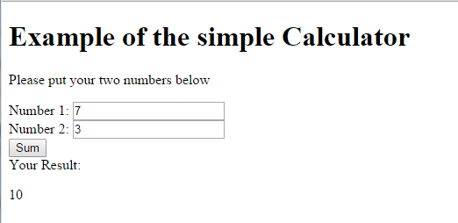
Example of the simple Calculator
Notes:
This is a simple calculator that we are going to learn to do it with java script today.

Slide 4
<!DOCTYPE html>
<html>
<body>
<h1> Example of the simple Calculator </h1>
<p> Please put your two numbers below</p>
Number 1: <input id="numb1" type="number">
<br />
Number 2: <input id="numb2" type="number">
<br />
Notes:
Please create a file called SimpleCalculator.html and add these code:
<!DOCTYPE html>
<html>
<body>
<h1> Example of the simple Calculator </h1>
<p> Please put your two numbers below</p>
Number 1: <input id="numb1" type="number">
<br />
Number 2: <input id="numb2" type="number">
<br />

Slide 5
<button type="button" onclick="mySum ()">Sum</button>
<br />
Your Result: <p id="result"></p>
<script>
function MySum () {
var x, y, z, text;
// Get the value of the input field with id="numb1"
x = Number(document.getElementById("numb1").value);
Notes:
<button type="button" onclick=“MySum ()">Sum</button>
<br />
Your Result: <p id="result"></p>
<script>
function MySum () {
var x, y, z, text;
// Get the value of the input field with id="numb1"
x = Number(document.getElementById("numb1").value);
// Get the value of the input field with id="numb2"
y = Number(document.getElementById("numb2").value);
z=x+y;
document.getElementById("result").innerHTML = z;
}
</script>
</body>
</html>

Slide 6
// Get the value of the input field with id="numb2"
y = Number(document.getElementById("numb2").value);
z=x+y;
document.getElementById("result").innerHTML = z;
}
</script>
</body>
</html>

Slide 7
Please save changes, and view your file in browser. Test your calculator.
Think how you can add some background colours. You can use HTML table to organise your layout.
Please add button to calculate multiplication:
<button type="button" onclick="Multiply()">Multiply</button>
You will need to write function to do multiplication and show results.
Notes:
Please save changes, and view your file in browser. Test your calculator. Think how you can add some background colours. You can use HTML table to organise your layout.
Please add button to calculate multiplication:
<button type="button" onclick="Multiply()">Multiply</button>
You will need to write function to do multiplication and show results.

Slide 8
Please add buttons and functions to do Subtraction and Division:

Slide 9
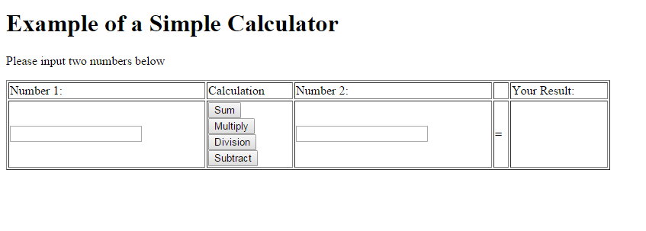
Create a HTML file SimpleCalculator_v2.html
You will need to modify your program that your calculator look like image below:

Slide 10
body {
font-family: "Comic Sans MS", cursive, sans-serif;
}
.tabTop {
font-size: 26px;
background-color: #00ccff;
text-align: center;
}
.tabBody {
background-color: #66ffff;
font-size: 22px;
text-align: center;
}
Notes:
Your next task is to write a css file ( call it myCalculatorStyle.css).
body {
font-family: "Comic Sans MS", cursive, sans-serif;
}
.tabTop
{
font-size: 26px;
background-color: #00ccff;
text-align: center;
}
.tabBody
{
background-color: #66ffff;
font-size: 22px;
text-align: center;
}
.myInput
{
width:150px;
height: 30px;
background-color: #ffff66;
font-size: 26px;
}
.myButton {
width:120px;
height: 30px;
background-color: #cc66ff;
font-size: 24px;
border-radius: 25px;
}

Slide 11
.myInput{
width:150px;
height: 30px;
background-color: #ffff66;
font-size: 26px;
}
.myButton {
width:120px;
height: 30px;
background-color: #cc66ff;
font-size: 24px;
border-radius: 25px;
}
Notes:
In CSS file please define classes for your table row (.myTopRow), for other row (.myRow) for your input (.myInput)

Slide 12
Now you need to connect this CSS file to your SimpleCalculator_v2.html
Your need to add a line of code in heard section
<link rel="stylesheet" href="styleCalculator.css">

Slide 13
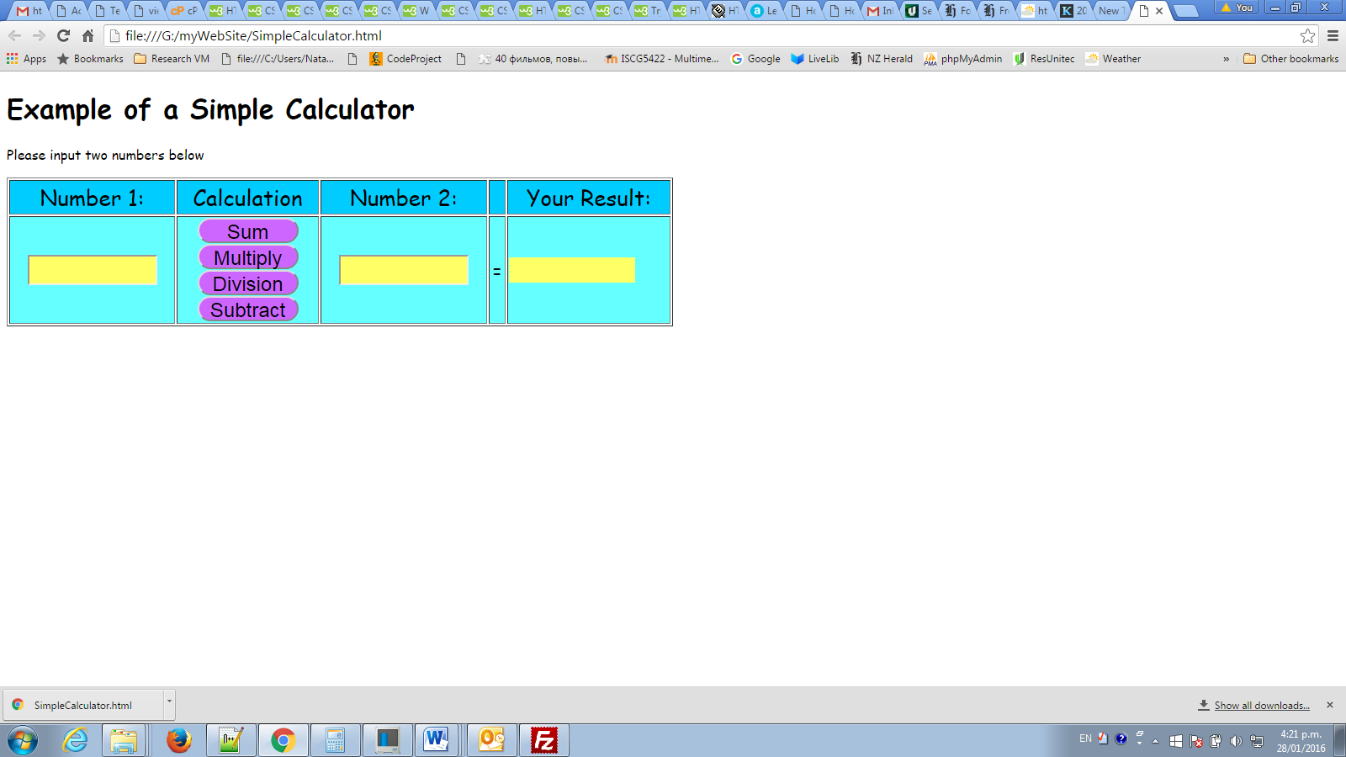

Slide 14
Switch statement
The switch statement is used to perform different actions based on different conditions.

Slide 15
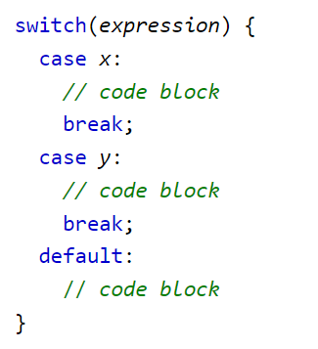
This is how it works:
The switch expression is evaluated once.
The value of the expression is compared with the values of each case.
If there is a match, the associated block of code is executed.
If there is no match, the default code block is executed.

Slide 16
Using switch case in your code
Open your simple calculator file and save it as exampleSwitchStatment.html
We are going to replace our four functions on one function. We will use switch statement and we will pass one parameter to tell function what to do.

Slide 17
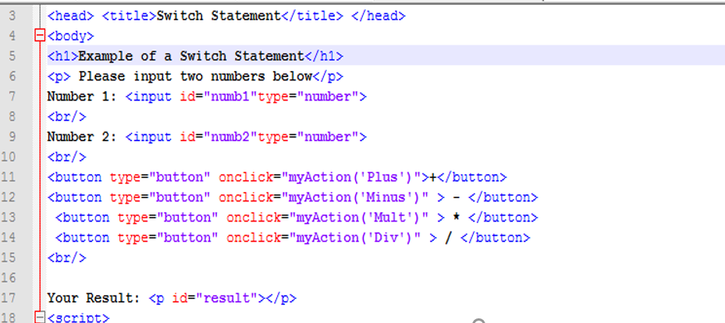

Slide 18
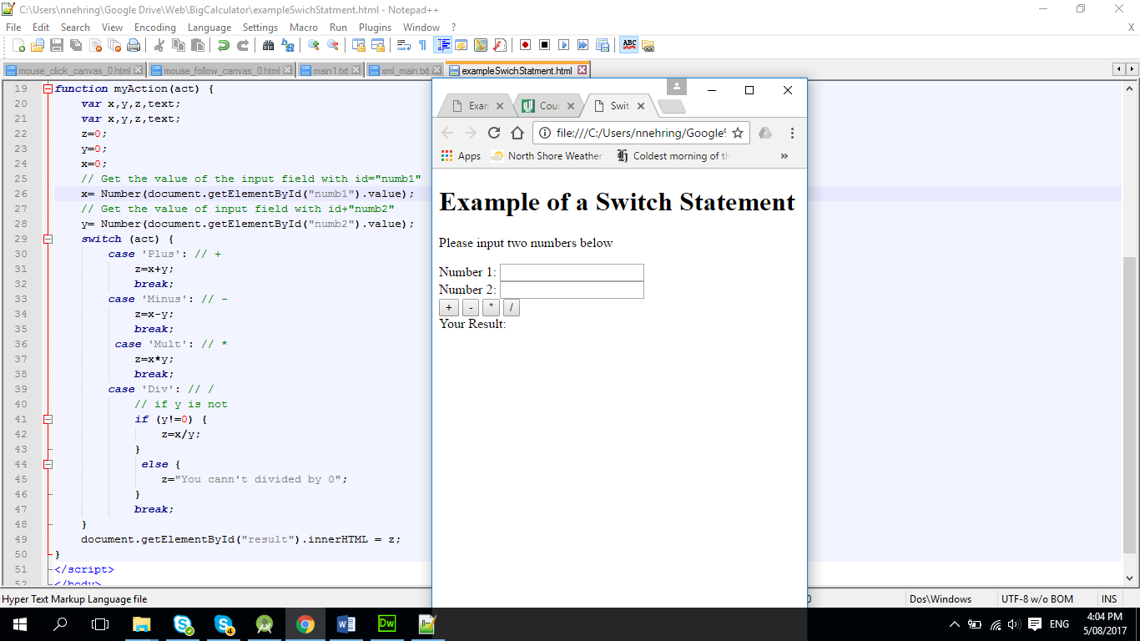

Slide 19
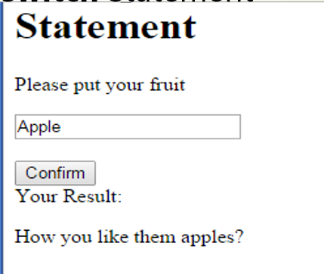
Practice - use switch Statement
You can use your file exampleSwichStatment.html save as mySwichPractice.html
You will need to write your own program which will accept user input in text box. Your button should call function, inside function you need to use switch statement;

Slide 20
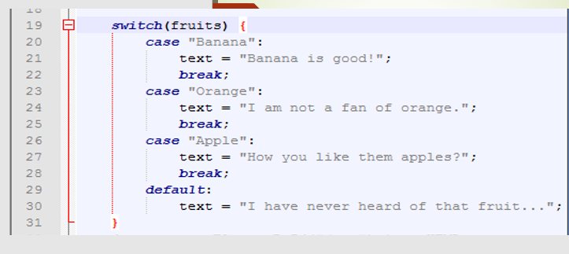

Slide 21
JavaScript Strings
A JavaScript string stores a series of characters like "John Doe".
A string can be any text inside double or single quotes:
var carname = "Volvo XC60"; var carname = 'Volvo XC60';

Slide 22
JavaScript Numbers
JavaScript has only one type of number.
Numbers can be written with, or without, decimals:
Example
var x = 3.14; // A number with decimals var y = 34; // A number without decimals

Slide 23
JavaScript Arithmetic Operators
Arithmetic operators are used to perform arithmetic between variables and/or values.

Slide 24
Given that y = 5, the table below explains the arithmetic operators:
Operator | Description | Example | Result in y | Result in x
+ | Addition | x = y + 2 | y = 5 | x = 7
- | Subtraction | x = y - 2 | y = 5 | x = 3
* | Multiplication | x = y * 2 | y = 5 | x = 10
/ | Division | x = y / 2 | y = 5 | x = 2.5
% | Modulus (division remainder) | x = y % 2 | y = 5 | x = 1
++ | Increment | x = ++y | y = 6 | x = 6
 |  | x = y++ | y = 6 | x = 5
-- | Decrement | x = --y | y = 4 | x = 4
 |  | x = y-- | y = 4 | x = 5

Slide 25
JavaScript String Operators
The + operator, and the += operator can also be used to concatenate (add) strings.

Slide 26
Operator | Example | text1 | text2 | text3
+ | text3 = text1 + text2 | "Good " | "Morning" | "Good Morning"
+= | text1 += text2 | "Good " | "Morning" | "Good Morning"
Operator | Description | Comparing | Returns
== | equal to | x == 8 | false
 |  | x == 5 | true
=== | equal value and equal type | x === "5" | false
 |  | x === 5 | true
!= | not equal | x != 8 | true
!== | not equal value or not equal type | x !== "5" | true
 |  | x !== 5 | false
> | greater than | x > 8 | false
< | less than | x < 8 | true
>= | greater than or equal to | x >= 8 | false
<= | less than or equal to | x <= 8 | true

Slide 27

JavaScript Arrays
An arrangement of objects, pictures, or numbers in columns and rows is called an array. This array has 4 rows and 3 columns. It can also be described as a 4 by 3 array.

Slide 28
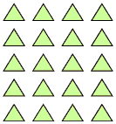
JavaScript Arrays
This array has 5 rows and 4 columns. It is a 5 by 4 array.

Slide 29


JavaScript Arrays
Look at the multiplication sentence that describes the array below. The numbers in multiplication sentences have special names.

Slide 30
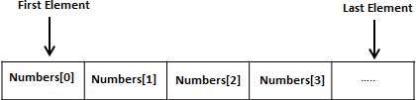
JavaScript Arrays
Notes:
Instead of declaring individual variables, such as number1, number2, ..., and number99, you just declare one array variable number of integer type and use number1[0], number1[1], and ..., number1[99] to represent individual variables. Here, 0, 1, 2, .....99 are index associated with var variable and they are being used to represent individual elements available in the array.
All arrays consist of contiguous memory locations. The lowest address corresponds to the first element and the highest address to the last element.

Slide 31
<html>
<head>
<title>Basic Javascript Array Example</title>
<script language="javascript">
// Empty array
var empty = [];
// Array containing initial elements.
var fruits = ['apple', 'orange', 'kiwi'];
alert(fruits[1]);
</script>
</head>
<body>
</body>
</html>
Notes:
<html>
<head>
<title>Basic Javascript Array Example</title>
<script language="javascript">
// Empty array
var empty = [];
// Array containing initial elements.
var fruits = ['apple', 'orange', 'kiwi'];
alert(fruits[1]);
</script>
</head>
<body>
</body>
</html>

Slide 32
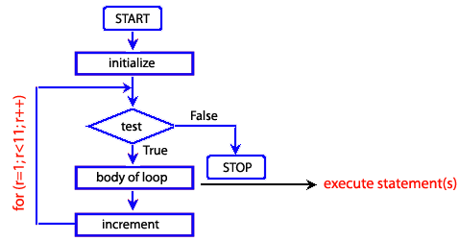
For Loops in JavaScript
for (i = 0; i < array.length; i++) { array[i]; }
Notes:
To loop through an array we need to use an index here we set it as i.
Starting from index zero the first element in the array to the end.

Slide 33
<!DOCTYPE html>
<html>
<body>
<p id="demo"></p>
<script>
var cars = ["mazda", "audi", "Saab", "Ford"];
var text = "";
var i;
for (i = 0; i < cars.length; i++) {
text += cars[i] + "<br>";
}
document.getElementById("demo").innerHTML = text;
</script>
</body>
</html>
Notes:
<!DOCTYPE html>
<html>
<body>
<p id="demo"></p>
<script>
var cars = ["mazda", "audi", "Saab", "Ford"];
var text = "";
var i;
for (i = 0; i < cars.length; i++) {
text += cars[i] + "<br>";
}
document.getElementById("demo").innerHTML = text;
</script>
</body>
</html>

